Slide 1

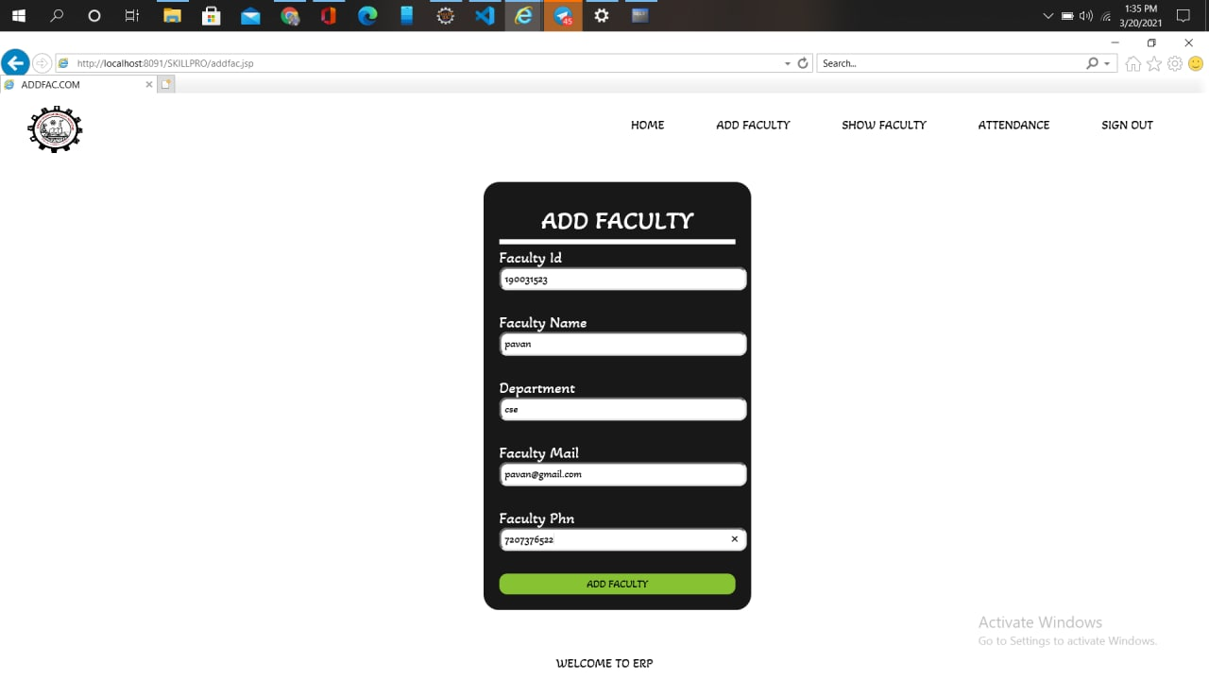
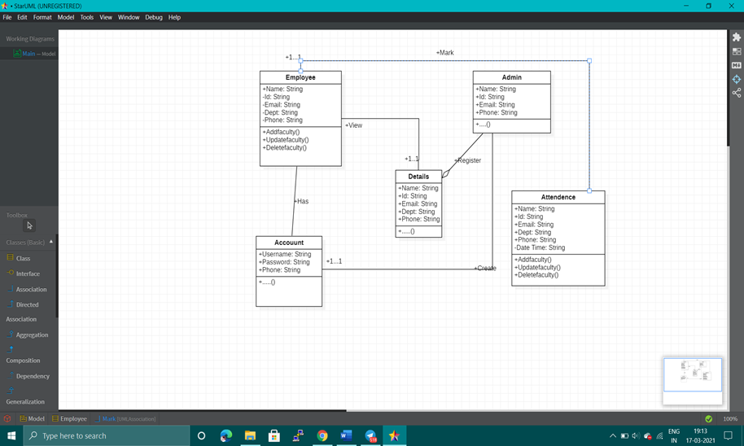
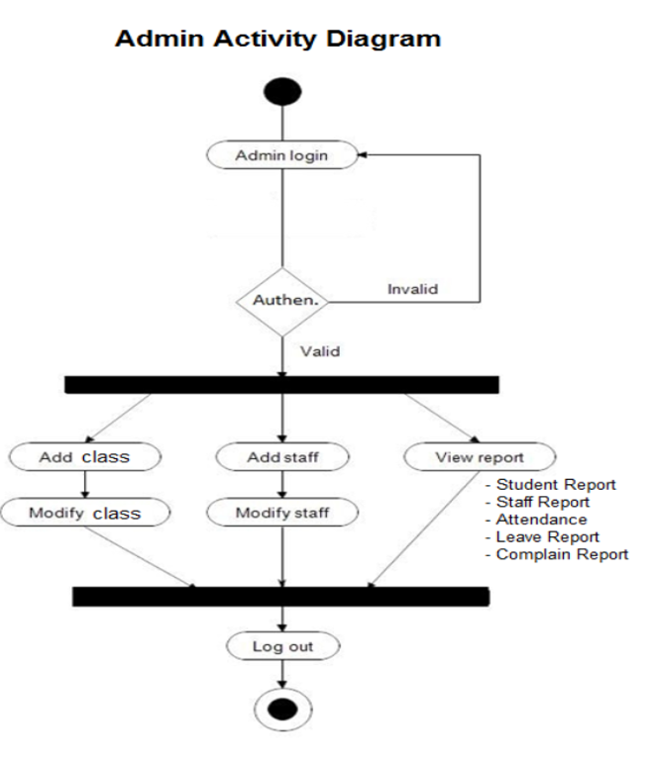
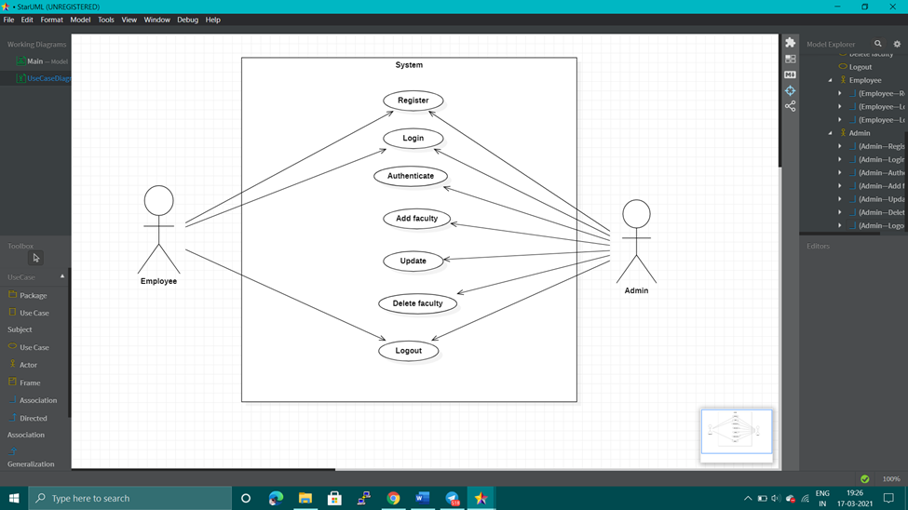
Employee Attendence Monitoring System
V Karan kumar(190031664),S Pavan kumar(190031523),
P Teja Kumar(190031901)
Name of the Supervisor: Dr Srinivas Rao , Ass Professor,
Department of CSE
Introduction
Block Diagram, Flowchart, UML Diagrams
Screenshots
Objective of your work
This web application retrieves the details of the departments assigned to the relevant administrative employees and employees enrolled in the courses from the server with the internet connection and stores them in the database.
Figure 1
Figure 1
Origin of your proposal
In this Employee Attendance Monitoring project, attempts were made to register the presence of employees. The main purpose is to maintain information about the presence that all employees can use in their departments.
Figure 1
.
rt
.
Conclusion
Modules
Discussion/Conclusion
This project is developed using html, css,Jsp javascript and fully meets the objective of the system which it has been developed. The software keeps record of employee’s attendance. The software is capable of easy storage of information related to employee through database. .
Limitations
Time saving due to digital management in software very less manual intervention. Secure data storage. Proper management of employee resources will lead to profit enhancement.
Future Direction
This project is helpful in maintaining the employee’s record, it also focuses on each employee’s attendance
Methods and Materials
Our Project consists of 4 Modules:
1.Admin Login
2. Admin Registration
3. CRUD Operations
4. Show Attendance
Figure 2
t

